Slide 1

California State preschool Program
(cspp)
2025 – 2026
8.26.25

Slide 2
What Is A CSPP?
The California State Preschool Program (CSPP) provides full-day services with a core class curriculum that is developmentally, culturally, and linguistically appropriate for the children served.
The Food Services Division provides breakfast and lunch to CSPPs on LAUSD campuses per California Universal Meals policy.

Slide 3
Overview & Purpose
This training will provide updated procedures for counting and claiming meals for the 2025-2026 school year for California State Preschool Program (CSPP) sites. The purpose of this training is to identify and understand the following:
Menus
EZ – Steps
Production Worksheets
Counting Procedures
Daily Entry for Claiming
CSPP Meal Count Form found on Café LA Website > Food Services Resources > Forms

Slide 4
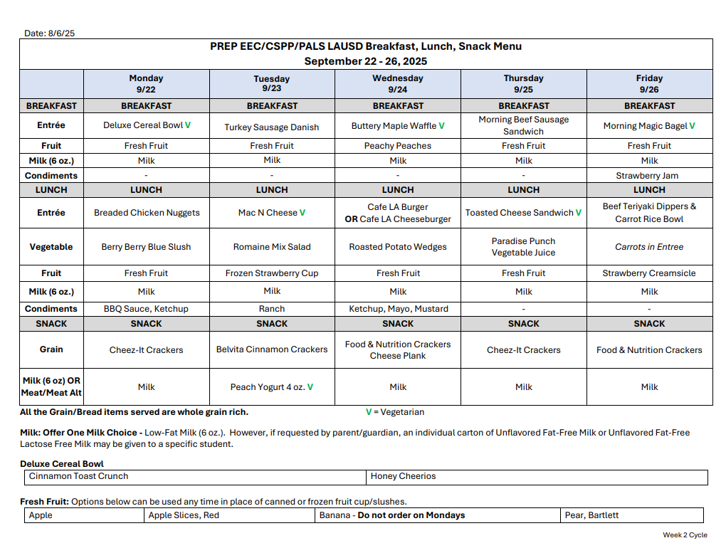
Menus
CSPP sites follow the EEC menu found on the Café LA website.
This ensures the proper daily and weekly meal pattern requirements are being met.
Choking hazard accommodations for preschool students are already included in the EEC menu.

Slide 5
Food Temperatures
Food safety is a primary concern in preschool aged children.
  Temperatures must be recorded during production, prior to and at the completion of each meal service
  The Temperature Log will be used at the main site and then transported with the food for completion
  Food Service staff is required to take the temperatures of the food, including milk

Slide 6
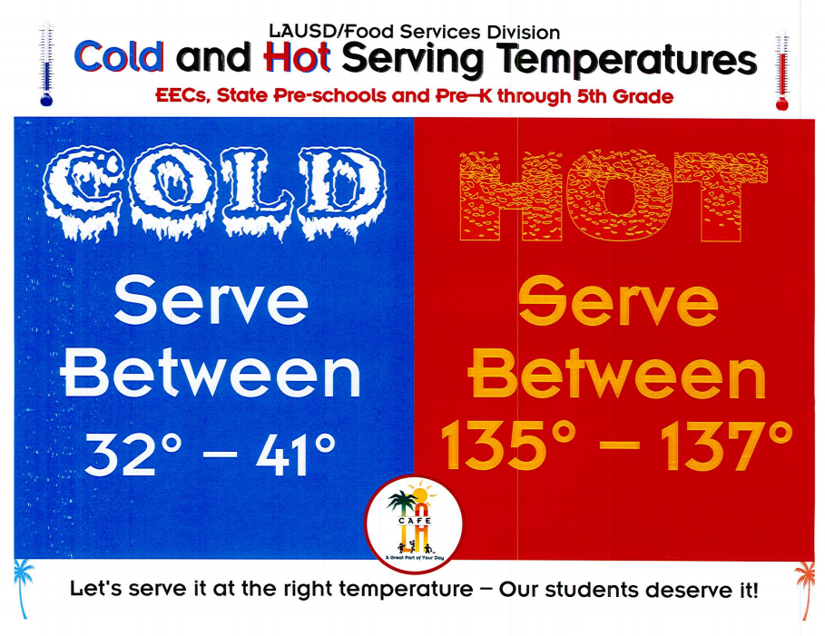
Food Temperatures
Hot food must be cooled before serving to students at CSPPs.
Temperature must be between 135 – 137 degrees.
Use insulated bags to insure proper temperature control during transport

Slide 7

Milk Requirements
The milk requirement for CSPP students is one 6 fluid ounce carton of milk to assure a full serving is offered when serving a reimbursable meal.
Low-fat (1%) or fat free (skim) milk for children two through five years old
No chocolate milk; must be unflavored for children ages one to five
If your main site has a CSPP, serve the 8oz milk, no need to order the 6oz milks for preschool students
If your main site has an EEC, serve the 6oz milk to the students

Slide 8
Requesting Special Meals
The FSM will follow the “Procedures for Requesting Special Meals” for students not on file and requesting a special diet:
  FSM are to provide the “Medical Statement to Request Special Diets” to families for completion by the child’s treating physician.
  The FSM will email the completed “Medical Statement to Request Special Diets” form to SpecialDiet@lausd.net
  FSM will make substitutions based on the special diet provided by the Nutrition Specialist.

Slide 9
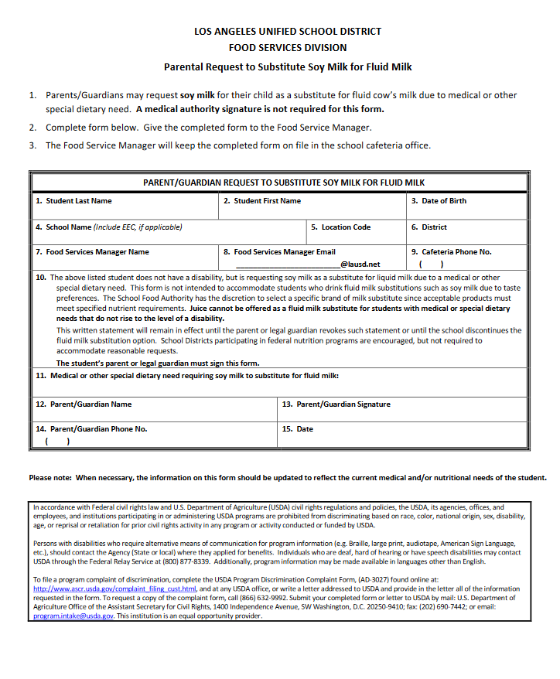
Procedure to Request Soy Milk
  Parents/Guardians may complete the “Parent/Guardian Request to Substitute Soy Milk for Fluid Milk” form and submit it to the School Food Service Manager.
  A medical authority signature is not required for the form.

Slide 10
CMS BOH Procedures

Slide 11
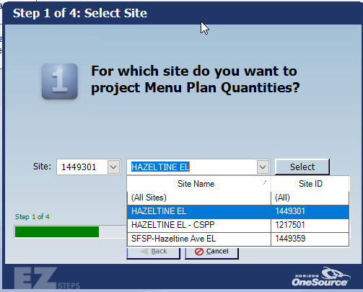
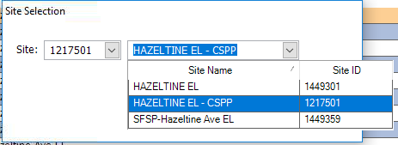
CSPP EZ – Steps
Managers at CEP sites need to complete separate EZ – Steps for their CSPP site.
Complete CSPP EZ - Steps before completing Main site EZ – Steps
Use dropdown box to select CSPP site
Ask school office for roster of students in CSPP
Use CSPP roster to project amounts of students participating in meal service

Slide 12
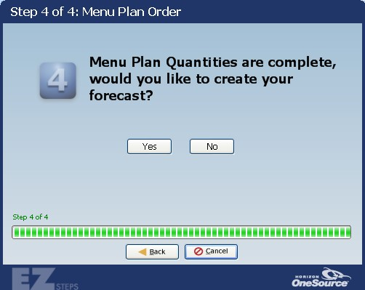
CSPP EZ – Steps: Create Forecast
At the end of the EZ – Steps for CSPP site, when question 4 asks if you would “like to create your forecast?” select NO.
After selecting No, complete EZ – Steps for main site.
Do not include CSPP counts into the main site EZ Steps projections.
Once arriving to question 4 on the main site EZ – Steps, select yes.

Slide 13
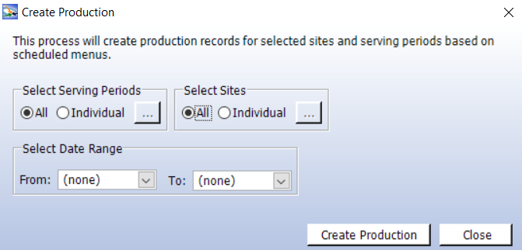
CSPP Production Records
Now that EZ – Steps have been created for the CSPP site, the CSPP will have its own Production Records to complete.
To Create Production go to:
Back of the House > Production > Create Production
Select All Serving Periods and select All Sites

Slide 14
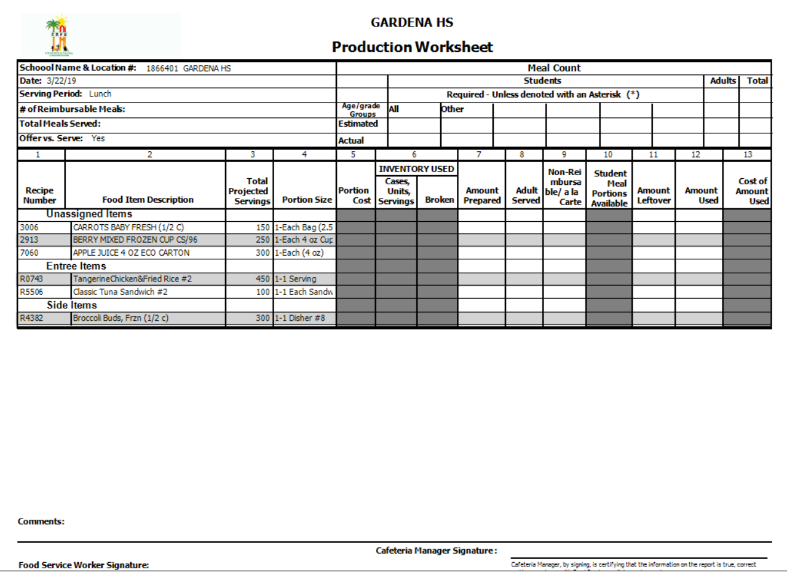
Main Site Daily Production
Do not include any CSPP meal counts on main site Production Worksheets.
Do not count CSPP meals on main site’s production. This will lead to an over claiming of meals
CSPP Breakfast 22

Slide 15
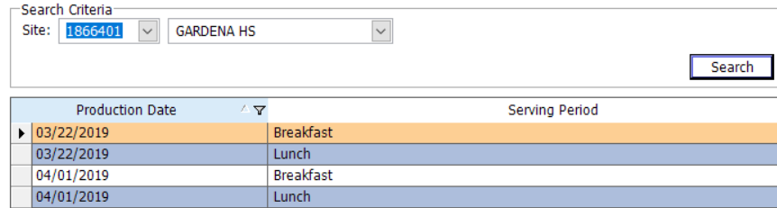
CSPP Daily Production
Select the CSPP site from the dropdown list to complete Daily Production.
Enter the amount prepared and leftover from service on CSPP Production Worksheet
Complete Daily Production for both breakfast and lunch

Slide 16
Newton foh Counting and claiming

Slide 17
Meal Service
As a state licensed program, breakfast and lunch services are written in the program’s curriculum time; therefore, CSPP students are not allowed to eat in the cafeteria eating area and must eat in their classroom.
Prepare meals and pack items in insulated bags for transport.
Communicate and coordinate with the program lead to initiate a plan of procedure for meal drop off to classroom or pick up from CSPP staff for breakfast and lunch services.

Slide 18
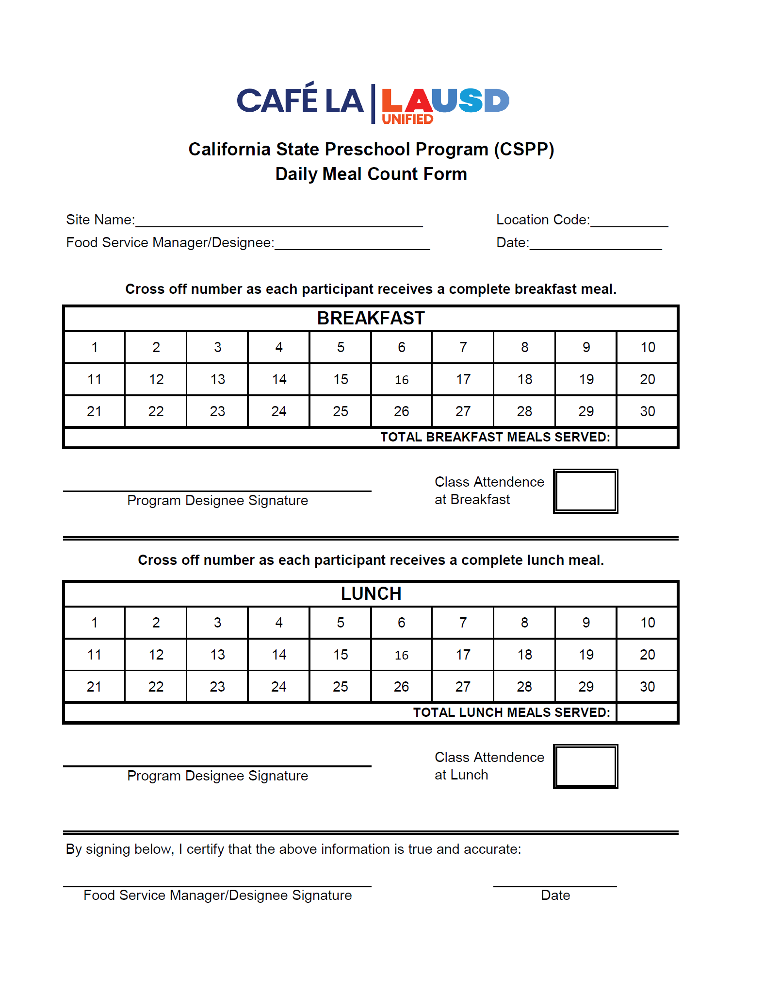
CSPP Daily Meal Count Form
The CSPP Daily Meal Count Form is used to account for all breakfast and lunch distributed to CSPP students on campus.
Provide the daily form to the classroom throughout the day for each service.

Slide 19
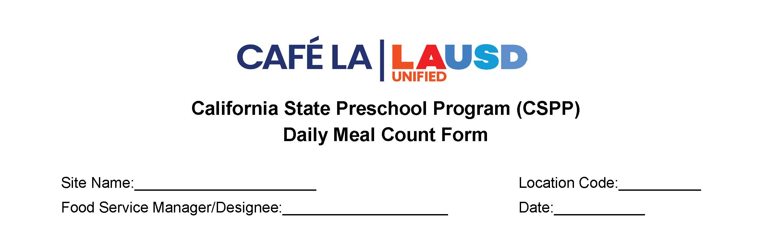
Header
The Food Services Manager or designee will complete the header section of the form.
  Site Name, Location Code, Name of Food Services Manager or Designee, and Date

Slide 20
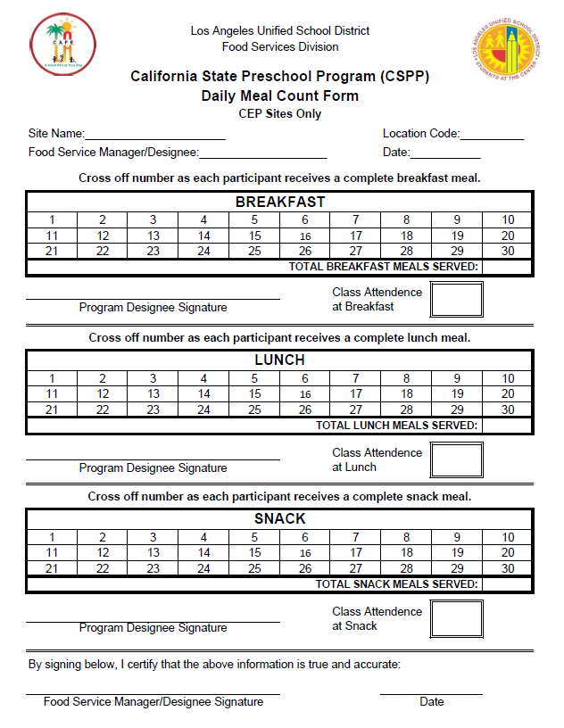
Counting
During each meal service a staff member will immediately mark off the meal as it is served.
  Cross off each number on the form after a child receives a complete meal
  At end of each service manually total the meals served
  CSPP staff must record the class attendance for each meal service

Slide 21
Verify
The Food Service Manager/Designee will verify all the information on the form, sign, and date in the designated area.

Slide 22
CSPP Claiming for Reimbursement
FSD collects claiming information from Newton FOH. There are two key areas in Post Operating Day that must be filled out to claim CSPP meals:
    Misc Counts
    Daily Figures

Slide 23

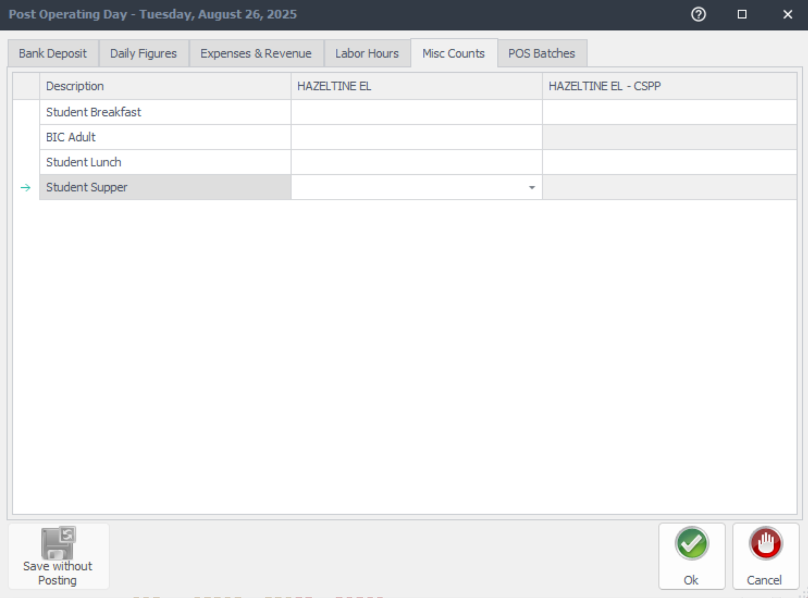
Misc Counts in Post Operating Day
To account for all CSPP meals served to students, FSD staff will record the amount in Newton Post Operating Day.
Click on the MISC Counts tab, select the CSPP site, and input number of meals served for:
Breakfast
Lunch

Slide 24
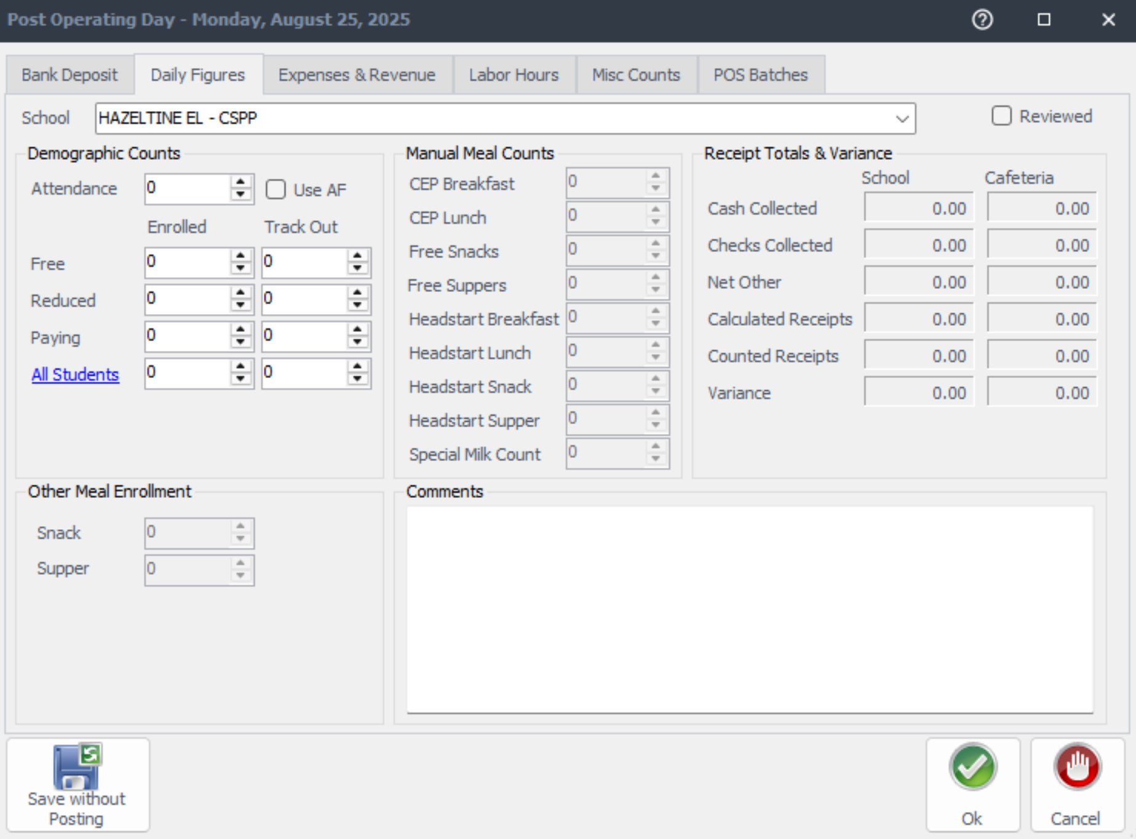
Demographic Counts in Daily Figures
  Complete the following under Demographic Counts:
    Verify attendance from the CSPP Daily Meal Count Form and input accurate number of students
    Enter the number of students enrolled at the CSPP under Free
    Reduced and Paying amounts stay at 0
    Click Reviewed

Slide 25
Supper for CSPP Students
CSPP students who want to participate in supper, must wait until the approved serving time after school hours for main site supper.
Students are counted on the Supper Community form; an aide or teacher can assist with their names since they are young children
Do not claim any meals on CSPP Misc Counts for Student Supper

Slide 26
Thank you

